Slide 1
APPLIED ENGLISH-SPANISH PHONOLOGY
Pablo Mejía Maldonado

Slide 2
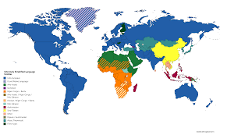
LANGUAGE BREAKDOWN
Language Family
VERBAL LANGUAGES

Slide 3
LANGUAGE BREAKDOWN
Individual Language
An individual language is a set of signs and rules (code) used by a larger or smaller community. As of 2021, there are some 7,139 living individual languages in the world. An individual language is a language considered as a whole of the same family that exists by itself specifically and is part of a language family; e.g, English, French, Spanish, Italian, Portuguese, and so on., which are part of the Indo-European language family.

Slide 4
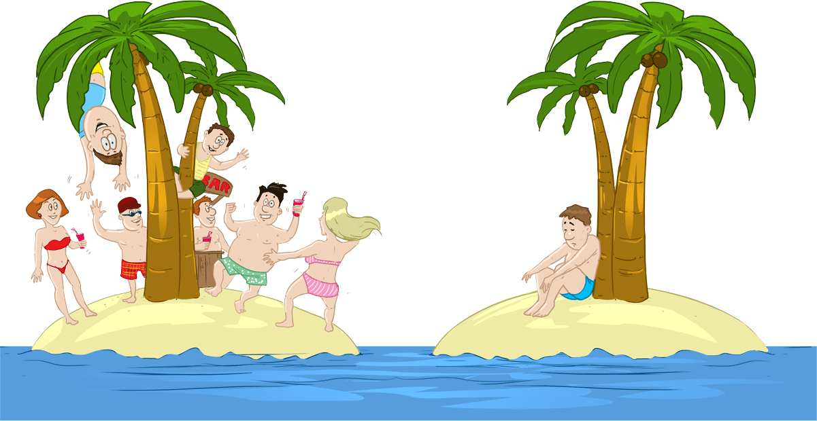
LANGUAGE BREAKDOWN
Isolated Language

Slide 5
LANGUAGE BREAKDOWN
Dialect
It is the variation of a language

Slide 6
LANGUAGE BREAKDOWN
Idiolect

Slide 7
LANGUAGE BREAKDOWN
synonyms: | specialized language, technical language
special words or expressions that are used by a particular profession or group and are difficult for others to understand.
Jargon

Slide 8
BRIEF CLASSIFICATION OF LANGUAGES
Colloquialism

Slide 9
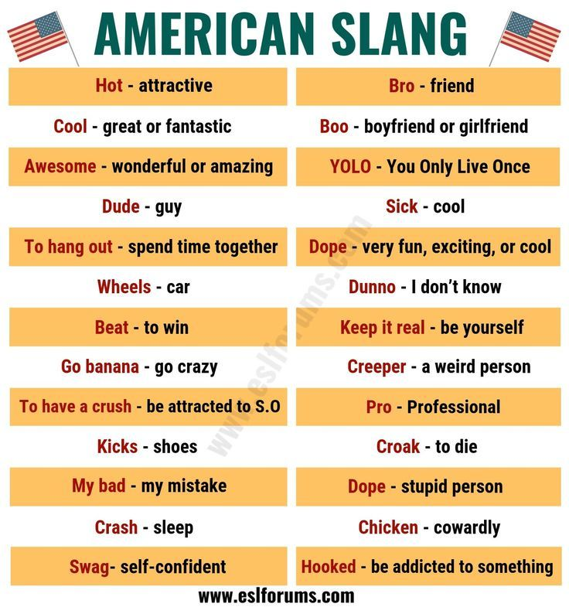
LANGUAGE BREAKDOWN
Slang
a type of language that consists of words and phrases that are regarded as very informal, are more common in speech than writing, and are typically restricted to a particular context or group of people.

Slide 10
LANGUAGE BREAKDOWN
NON VERBAL LANGUAGES
written or symbolic languages
idiographic Language
Syllabic Language
use ideograms symbols
i.e; Chinese
use one symbols per
syllable; i.e, Japanese
alphabetic Language
articulated Language
sound pronunciation
Use alphabetical symbols.
Such as Spanish and English
letters
organs of speech to
produce sounds. Phonetic
Alphabet IPA symbols.

Slide 11
LANGUAGE INCONSISTENCIES
It is the incompatibility, quality or state of being inconsistent. It is the lack of concordance with a structural pattern.
These inconsistencies happen since:
1.- The same letter or letter combination can refer to different sounds
Spanish
English
letter [ˈlƐ:ɾɚ]
tip [ˈtʰɪpˉˡ ]
cerda [ˈserđa]
casa [ˈkasa]
<- consonant letter ->
Spanish vowels do not change their qualities
steak [ steɪ̯k ̚ ]
head [ hɛːd ]
<- vowel letter ->

Slide 12
LANGUAGE INCONSISTENCIES
2.- Same sound may have different letters or letter combinations.
[ˈwɪmɪn] women
[ˈbɪzɪ] busy
Spanish
English
[ˈboske] bosque
[ˈbaso ] vaso

Slide 13
LANGUAGE INCONSISTENCIES
3.- Different dialects pronounce the same word differently.
stop [ˈstapˉˡ] American English
[ˈstɒpˉ] British English
Spanish
English
<pan> [pãn] Ecuador – Tulcán
[pãŋ] Ecuador – Quito
corazón [koɾaˈsɔ̃ŋ] Ecuador
[koɾaˈθɔ̃n] Spain
water [ˈwɔ:ɾɚ]American English
[ˈwɔtə ] British English

