Slide 1
Spanish - English
Pablo Mejía Maldonado

Slide 2
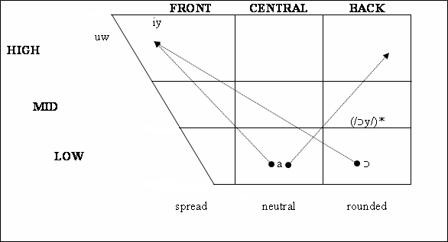
DIPHTHONGS
Vowel sound follow by non-adjacent glide in the same syllable.
English
Spanish

Slide 3
English /ej/
/ej/ Voiced, Complex (adjacent glide),
Mid-Front, Tense, Spread
<a> came /kejm/
<ai> wait /wejt/
<ay> say /sej/
<eigh> sleigh /slej/
<ea> steak /stejk/
<ey> obey /əˈbej/
<ei> vein /vejn/
<aight> straight /’stɹet/
[ɛɪ̯ː]← vdc lengthened.
[ɛɪ̯ː]← vlc unlengthened.

Slide 4
English /ow/
<ew> sew /’sow/
<o> cold /’kowld/
<oa> loaf /’lowf/
<oe> toe /’tow/
<ou> soul /’sowl/
<ough> though /’δow/
<ow> show /’ʃow/
/ow/ Mid-Back, Tense, Rounded
[ɔʊ̯ː]← vdc Lengthened.
[ɔʊ̯]← vlc Unlengthened.

Slide 5
SPANISH and ENGLISH DIPHTHONGS /aw/, /aj/ and /oj/
<ou> sound /’sawnd/
<ow> croad /’kɹawnd/
<ough> bough /’baw/
<au > aurora /aw’ ɾoɾa/
Spanish /aw/
English /aw/
<ei> height /’hayt/
<ey> geyser /’gayzəɹ/
<i> wife /’wayf/
<ie> pie /’paj/
<igh> sigh /’saj/
<uy> buy /’baj/
<y> my /’maj/
<ai> fraile /’fɾayle/
<ay> hay /’aj/
Spanish /aj/
English /aj/
<oi> coima /’koyma/
<oy> soy /’soy/
Spanish /oj/
English /ɔj/
<oi> oil /’ɔjl/
<oy> boy /’bɔj/

Slide 6
PHONETIC AND PHONEMIC FEATURES
ENGLISH
/aw/ Voiced, Complex (non-adjacent glide), Low-Central becoming High-Back, Neutral becoming Rounded.
SPANISH
/ɔj/ Voiced, Complex (non-adjacent glide), Low-Back becoming High-Front, Rounded becoming Spread.
/aj/ Voiced, Complex (non-adjacent glide), Low-Central becoming High-Front, Tense, Neutral becoming Spread.
/oj/ Voiced, Complex (non-adjacent glide), Mid-Back becoming High-Front, Rounded becoming Spread.
[aʊ̯] Voiced, Complex (non-adjacent glide), Low-Central becoming High-Back, Neutral becoming Spread, Unlengthened.
[a] Voiced, Complex (non-adjacent glide), Low-Central becoming High-Front, Tense Neutral becoming Spread, Unlengthened.
[ɔɪ̯:] Voiced, Complex (non-adjacent glide), Low-Back becoming High-Front, Rounded becoming Spread, Lengthened.
[aʊ̯:] Voiced, Complex (non-adjacent glide), Low-Central becoming High-Back, Neutral becoming Rounded, Lengthened.
[oɪ̯] Voiced, Complex (non-adjacent glide), Mid-Back becoming High-Front, Rounded becoming Spread, Unlengthened.
[a:] Voiced, Complex (non-adjacent glide), Low-Central becoming High-Front, Tense Neutral becoming Spread, Lengthened.
[ɔɪ̯] Voiced, Complex (non-adjacent glide), Low-Back becoming High-Front, Rounded becoming Spread, Unlengthened.
[aʊ̯] Voiced, Complex (non-adjacent glide), Low-Central becoming High-Back, Neutral becoming Rounded, Unlengthened.

Slide 7
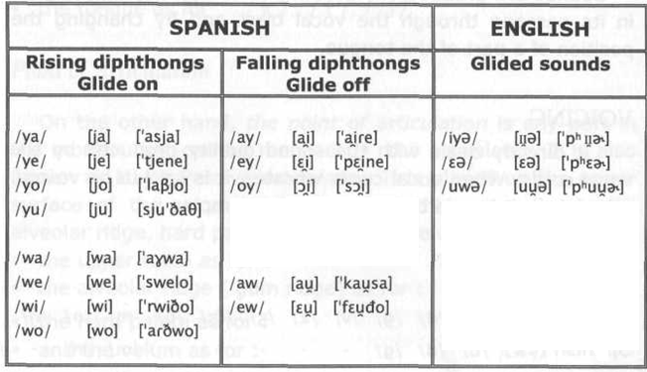
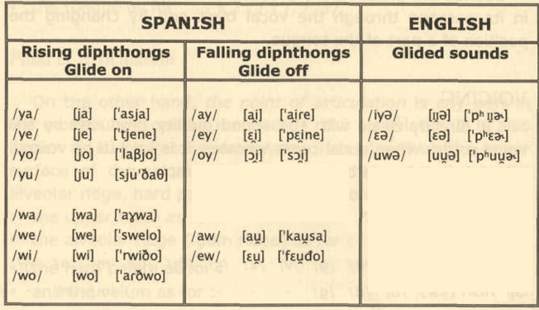
OTHER GLIDED SOUNDS

