Slide 1
APPLIED ENGLISH-SPANISH PHONOLOGY
Pablo Mejía Maldonado

Slide 2
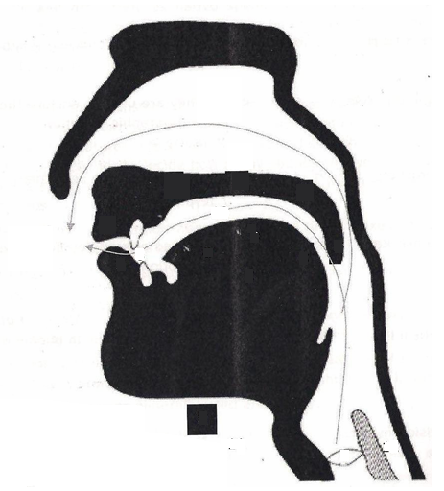
DIAGRAM OF THE SPEECH ORGANS
Vocal cords
tongue
a. apico segment
b. fronto segment
c. dorso segment
3. lower lip
4. uvula
5. jaw
6. palate
a. alveolar section
b. palatal section
c. velar section
7. upper lip
8. teeth
9. nasal passage
10. oral passage
11. larynx
12. esophagus
13. air flow
9
Passive Articulators
6
a
b
c
7
10
13
8
a
b
c
4
4
3
2
Active Articulators
5
1
12
11

Slide 3
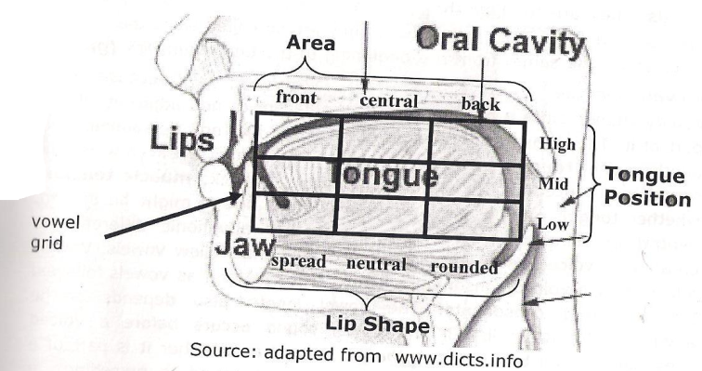
THE VOWEL INVENTORY
VOWEL
DIPHTHONGS
It is a speech sound produced
When vowels occur
by human beings when
in combinations (strong+ weak), they are
breath flows out through mouth
called diphthongs
without being blocked by
teeth, tongue nor lips

Slide 4
VOWEL PRODUCTION
Voicing
Vowel Quality
Monphthongs
(Pure vowels)
Every vowel is voiced in both languages
Diphthongs
Spanish
English
/ej/, /ow/, /aj, /ɔj, /aw/, /jƏ/
/a/, /e/, /i/, /o/, /u/
/i/, /a/,/æ/,/ɛ/,/ɪ/,/ɔ/,/Ə/,/Ʊ/, /u/
Tongue Height
Roundness
High, mid, or low
Spread, neutral or rounded
Backness
In which the sound is produced. These are front, central or back
Vowel length
Muscle Tension
Difference is created by voiced and non-voiced
consonants that follow vowels
Whether tongue muscle is tense or lax

Slide 6
ENGLISH – SPANISH VOWEL PHONEME QUADRANT
Mejía, P. (2013). Contrastive Phonology.
not all dialects of English maintain
a distinction between the lax mid back vowel [ɔ]
and low vowel [a]
these merging dialects
words like caught and dawn are pronounced with [a]
do not have [ɔ]

Slide 7
PHONEMIC AND PHONETIC VOWEL CONTRAST
SPANISH /i/ - ENGLISH /i/, / ɪ^{y}/, /ɪy/ and /ɪ/
Spanish /i/
English /i/
English /ɪ/
<i> ira /ˈiɾa/
<ee> week /wik/
<ea> tea /ti/
<e> these /δiz/
<y> money /ˈmani/
<ie> believe /bɪˈliv/
<ei> receive /ɹɪˈsiv/
<i> ski /ski/
<ey> key /ki/
<eo> people /ˈpipəl/
<oe> amoeba /aˈmibə/
<i> sit /ˈsɪt/
<y> rhythm /ˈɹɪδəm/
<u> busy /ˈbɪzɪ/
<ui> build /ˈbɪld/
<e> economy /ɪˈkanəmi/
<ee> deer /ˈdɪəɹ/
<o> women /ˈwɪmɪn/
SPELLINGS

Slide 8
PHONETIC AND PHONEMIC FEATURES
SPANISH /i/
ENGLISH /i/- /ɪ/
/i/
high-front, tense, spread
/ɪ/
high-front, lax, spread
high-front, tense, spread.
[i] unlengthened
[ ĩ ] nasalized
[iː]← vd.c lengthened.
[i]← vls.c unlengthened.
[i:]← vd.c lengthened.
[i]← vl.c unlengthened.

Slide 9
SPANISH /e/ - ENGLISH /Ɛ/
Spanish /e/
Spanish /e/
Spanish /e/
English / Ɛ /
<e> tren /tɾen/
<e> let /lƐt/
<ea> head /hƐd/
<ai> said /sƐd/
<a> many /’mƐnɪ/
<ie> friend /fɹƐnd/
PHONETIC AND PHONEMIC FEATURES

Slide 10
PHONETIC AND PHONEMIC FEATURES
SPANISH /e/
ENGLISH /ɛ/
/ɛ/ mid-front, lax, spread
mid-front, tense, spread.
[ɛ:]← vd.c lengthened.
[ɛ]← vls.c unlengthened.
[e] ← unlengthened
[ẽ] ← nasalized
[ɛ] ← open
[ɛ̃] ← open-nasalized

Slide 11
SPANISH /a/ - ENGLISH /a/ and /æ/
Spanish /a/
English /a/
English /æ/
<a> cárcel /ˈkaɾsel/
<a> calm /kam/
<e> encore /ˈaŋkəɹ/
<o> not /nat/
<ow> knowledge /’nalɪʤ/
<a> hat /hæt/
<au> laugh /læf/
PHONETIC AND PHONEMIC FEATURES
SPANISH /a/
ENGLISH
low-central, tense, neutral.
/a/
low-central, tense, neutral.
/æ/
low-front, lax, spread
[a] ← unlengthened
[ã] ← nasalized
[a:]← vd.c lengthened.
[a]← vls.c unlengthened.
[æ:]← vd.c lengthened.
[æ]← vs.lc unlengthened.

Slide 12
.
ENGLISH /ʌ/ - /ə /
Stressed Syllable
<o> mother /ˈmʌδəɹ/
<oo> blood /blʌd/
<u> hut /hʌt/
<ou> young /ʝʌŋ/
Unstressed Syllable
<a> about /əˈbawt/
<e> problem /ˈpɹabləm/
<eou> righteous /ˈɹajtʃəs/
<o> today /təˈdej/
<u> success /səkˈsɛs/
SPELLINGS
ENGLISH /ə/
mid-central, lax, neutral
[ə]← vdc unlengthened.
[ʌː] ← vd.c lengthened, stressed
[ʌ] ← vls.c unlengthened, stressed

Slide 13
SPANISH /o/ - ENGLISH /ɔ/
Spanish /o/
English /ɔ/
<o> amor /aˈmoɾ/
<a> war /wɔɹ/
<au> author /ˈɔθəɹ/
<aw> awl /ɔl/
<o> dog /dɔg/
<oa> broad /bɹɔd/
<ou> ought /ɔt/
SPELLINGS

Slide 14
PHONETIC AND PHONEMIC FEATURES
SPANISH /o/ - ENGLISH /ɔ/
SPANISH /o/
ENGLISH /ɔ/
mid-back, tense, rounded
/ɔ/
mid-back, lax, rounded
[o] unlengthened
[õ] nasalized
[ɔ]← vd.c unlengthened.
[ɔ:]← vdc lengthened.
[ɔ] open.
[ɔ̃] open, nasalized

Slide 15
SPANISH /u/ - ENGLISH /Ʊ/ and /u/
Spanish /u/
English / Ʊ /
English /u/, /u^{w}/ /uw/
<u> puro /ˈpuɾo/
<o> woman /ˈwƱmən/
<oo> book /bƱk/
<ou> could /kƱd/
<u> put /pƱt/
<ew> few /fjuw/
<o> do /duw /
<oo> room /ɹuwm/
<ou> you /ʝuw/
<u> luke /luk/
<ue> blue /blu /
<ui> fruit /fɹut/
SPELLINGS

Slide 16
PHONETIC AND PHONEMIC FEATURES
SPANISH /u/
ENGLISH
/ʊ/
high-back, lax,
rounded
high-back, tense, rounded
/u/ high-back, tense, rounded
[u] unlengthened
[ũ] nasalized
[ʊ:]← vd.c lengthened.
[ʊ]← vls.c unlengthened.
[uː] ← vd.c lengthened.
[u] ← vls.c unlengthened.

