Slide 1
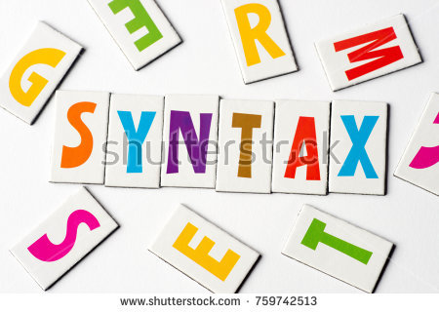
COMPLEX Sentences
SUBORDINATING CLAUSE

Slide 2
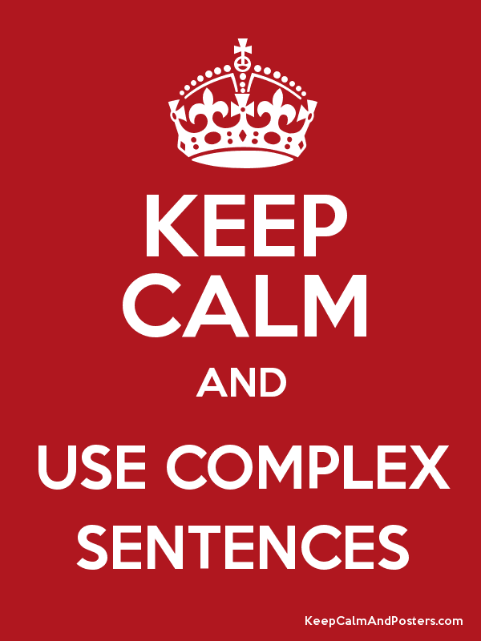
SUBORDINATE CLAUSE OR COMPLEX SENTENCES
It does not express a complete thought. Cannot stand by itself as a complete sentence.
The meaning of a subordinated clause is complete only when the clause is attached to an independent clause.
A word such as that, what or since often signals the beginning of subordinated clause.
Reference: Warriner, John E. English Grammar and Composition: Complete Course. Franklin ed., Harcourt Brace Jovanovich, Inc., 1982.

Slide 3
To attach subordinate clause, we use one of the following structures:
in front of a main clause.
SUBORDINATE CLAUSE + , + MAIN CLAUSE .
at the end of a main clause.
MAIN CLAUSE + Ø + SUBORDINATE CLAUSE.

Slide 4
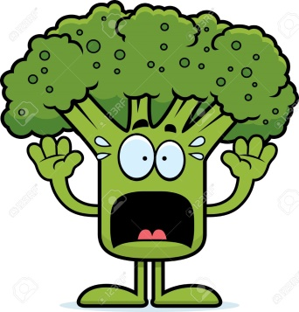
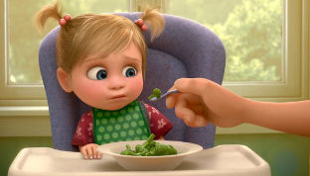
EXAMPLE:
Even though the broccoli was covered in cheddar cheese , Emily refused to eat it.
Even though
Subordinate conjunction
the broccoli was covered in cheddar cheese ,
Subordinate clause
Emily refused to eat it
Main Clause

Slide 5
EXAMPLE:
The store did not have the video game that I wanted.
The store did not have the video game that I wanted
Main Clause
Subordinate conjunction
Subordinate clause

Slide 6
NOUN CLAUSES
Noun clause is a subordinate clause that functions as a noun.
It can do anything a noun can do except be an appositive:
Subject, Predicate
Direct Object,
Indirect Object,
Object of the Preposition.

Slide 7
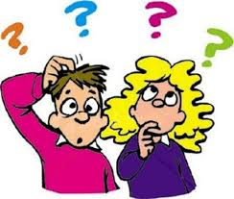
EXAMPLES:
Subject
1. How you feel is not important.
1. Where he lives is unknown.
Direct Object
2. I don't know what the man requires.
2. I don’t mention who he is.

Slide 8
Indirect Object
3. The security officer gave whoever wanted it the key
Object of Preposition
You may ask about whatever you don’t understand.
Prep. Noun Clause
(Object of Preposition)

Slide 9
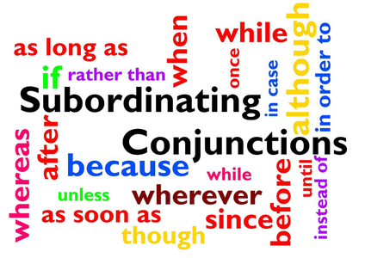
SUBORDINATE CONJUNCTIONS
Subordinating conjunctions are linking words which connect one dependent clause to an independent clause.
It always comes in the beginning of a dependent clause
O N A W H I T E B U S

Slide 10
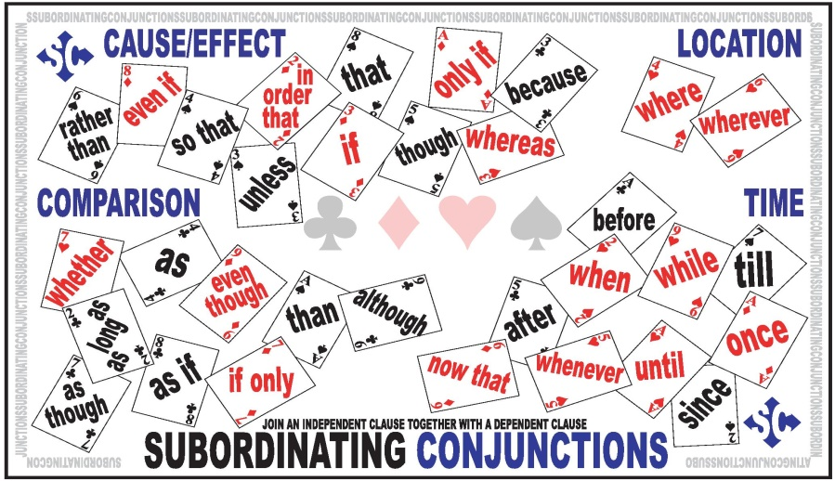
SUBORDINATE CONJUNCTIONS
O N A W H I T E B U S
Once
Now that
After, Although, As

Slide 11
SUBORDINATE CONJUNCTIONS
ON A W H I T E B U S
When, whenever, whether, where, wherever, while, why , whereas
How
Even if, even though,
except
If, If only, in case, in order
Though, than, that

Slide 12
SUBORDINATE CONJUNCTIONS
ON A WHITE B U S
Because, Before
Since, So that
Unless, Until,

Slide 13
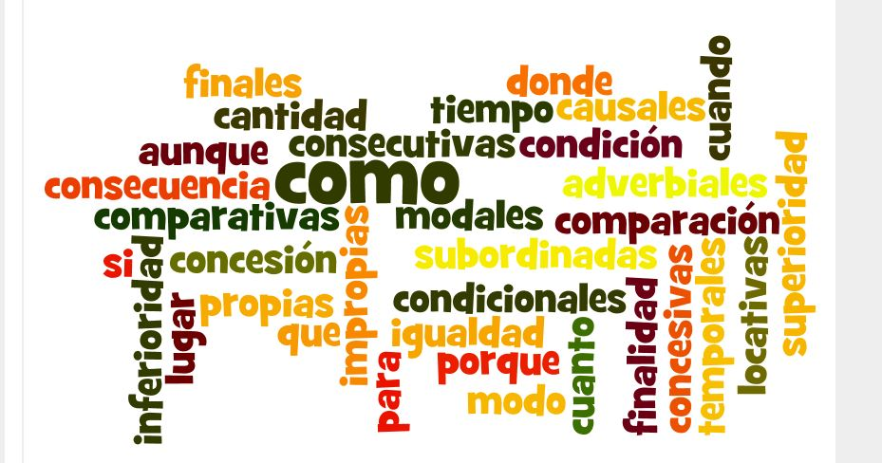
Conjunciones Subordinantes
Consecutivas
Concesivas
Causales
Temporales
Finales
Condicionales
con que, luego, así que, pues bien, por (lo) tanto, de manera que
si, como, cuando, siempre que
(para) que
aunque, por más que, por mucho que, aun cuando
en cuanto, tan pronto como
porque, pues, dado que, puesto que, ya que

Slide 14
Proposiciones Subordinadas Sustantivas
Las oraciones subordinadas sustantivas equivalen a un sustantivo o sintagma nominal, por lo que desempeñan las mismas funciones que éste (sujeto, atributo, CD, término de un sintagma preposicional).

Slide 15
Características
Van introducidas por un nexo o un infinitivo.
Son conmutables por un sustantivo. Pero no siempre es posible la sustitución.

Slide 16
Ejemplos:
El que tengas poder y riqueza no te da ningún derecho. (Sujeto)
Me comunicó que vendría tarde (Objeto Directo)
El guitarrista le dedica mucho tiempo a quien es más lento (Objeyo Indir.)
Mi intención es aprobar en junio (Predicativo)

Slide 17
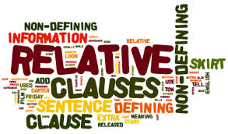
ADJECTIVE CLAUSES
Relative-Clause function is to give supplementary information about a person, thing or situation.
These sentences always depend on the Noun or pronoun, they are introduced by relative pronouns (who, which, whose, that) or other conjunctions like (when or where)

Slide 18
Defining Relative Clauses
The information they supply is essential for the sentences to have sense, we use defining clause to identify a thing, person or animal.

Slide 19
Non-Defining Relative Clauses
The information they supply is non-essential
Extra information
Commas
‘That’ cannot be used

Slide 20
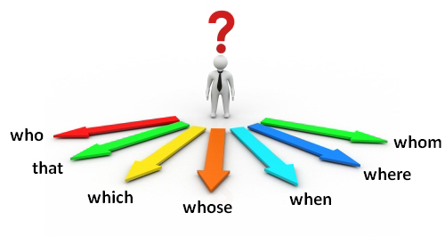
RELATIVE CONJUNCTIONS
It’s the place where I was born
The year when I was born was very cold
The reason why I am here is to convince you to come to the party.
The man who lives on the second floor is a doctor.
The book which you gave me is interesting
The man who you saw is my brother
I saw the boy whose father is a doctor

Slide 21
ADVERBIAL CLAUSES
CUANDO, MIENTRAS,
ANTES QUE,
ANTES DE QUE,
DESPUÉS DE QUE.
Ejemplo:
Se altera cuando explica los ejercicios de matemáticas
NEXO
Det
N
Prep
N
N.V
N.V
S. Prep
S.V (pred Verbal)
Prop. Sub.Adverbial de tiempo
Notes:
ahota

Slide 22
Apenas lo sepas, llámame.
As soon as she finished that project, she started working on the next
After I have finished my work, I will accompany you to the park.
Lo hice como usted ordenó.
Atendiendo en la clase, aprobaré el examen.
Debes prepararte ya que es tu última oportunidad de aprobar el semestre.

Slide 23
Estoy contento que todo haya salido bien
Vivo esperanzado con que la verdad prevalecerá
Adjetivo
Adjetivo

