Slide 1
THE ADVERB

Slide 2
SPANISH | ENGLISH
ADVERBIO = Palabra que complementa a un verbo, adjetivo u otros adverbios. Actúan como modificadores o complementos de un verbo o frase verbal. | ADVERB = Words that describe verbs, adjectives, and other adverbs.
Expresan circunstancias, como: modo, lugar, tiempo, cantidad, afirmación, o duda. Responden a: ¿cuándo?, ¿dónde?, ¿cómo?, ¿de qué manera? | Tells the readers how, where, when, or the degree at which something was done.

Slide 3
They can shift around the sentence.
Modifying adjectives:
Kate is a stunningly beautiful girl.
(adverb modifying the adjective)
Before the verb:
David quickly walks
After the verb:
David walks quickly
As an opener
Quickly, David walks
Modifying adverbs:
I nearly always agree with the local newspaper’s position.
(adverb modifying the adverb)

Slide 4
La posición del adverbio depende de la función que desempeña en la oración
Antes
She suddenly drove off.
Ella repentinamente se alejó.
Después
She drove off suddenly.
Ella se alejó repentinamente.
Inicio
Suddenly, she drove off.
Repentinamente ella se alejó

Slide 5
Adverb Clauses can't Stand Alone
SPANISH | ENGLISH
Ejemplos de cláusulas adverbiales: tan pronto como lo recibo cuando esté lista la cena. antes de ir de compras. | Examples of adverbial clauses. until I fall asleep whenever my teacher yells after I walk the dog
¿Qué sucede? | What is going on.?

Slide 6
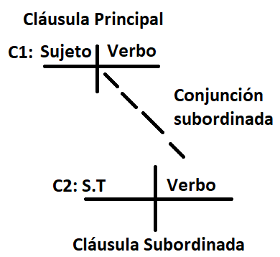
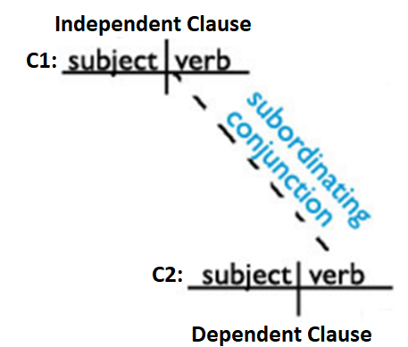
Adverb Clauses are Subordinate Clauses
Formato en diagrama
Diagrammed Format

Slide 7
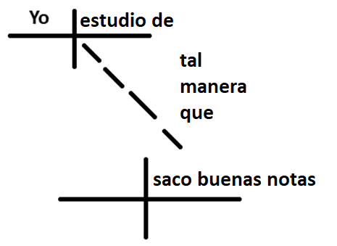
I read because I love stories
Yo estudio de tal manera que saco buenas notas.

Slide 8
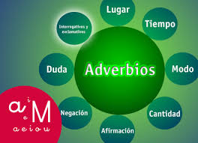
FUNCIÓN SINTÁCTICA DEL ADVERBIO

Slide 9
IN SPANISH!

Slide 10
Complemento circunstancial del verbo
Cuantificador
Grado o complemento del adjetivo
Cuantificador de otro adverbio
Núcleo del sintagma adverbial
es
Función Sintáctica
además
Expresa circunstancias:
-modo, lugar, tiempo, cantidad, afirmación, duda, etc…
ADVERBIO
Respondiendo preguntas
¿cuándo?, ¿dónde?, ¿cómo?, ¿de qué manera?, entre otras…
Clases
Funciones
Adverbios de ubicación
Función de Epistémicos
Modificador de
una Oración (Proposición).
Ej: Afortunadamente, no ha pasado nada.
De lugar: aquí, allá, arriba, abajo, cerca, lejos, atrás, alrededor...
De tiempo: todavía, aún, ya, ayer, hoy, mañana, siempre, nunca, jamás, próximamente, mientras…
De modo: bien, regular, despacio, como, aprisa, adrede, fielmente, responsablemente —todas las que se formen con las terminaciones «mente»—
De cantidad o grado: muy, poco, mucho, algo, casi, solo, solamente, tan, tanto, todo, nada, aproximadamente…
De afirmación: sí, también, cierto, efectivamente, claro, exacto, obvio, seguramente, asimismo, etc.
De negación: no, jamás, nunca, tampoco.
De orden: primeramente, últimamente.
De duda: quizá(s), acaso, probablemente, seguramente, tal vez, puede ser, a lo mejor.
Interrogativos/exclamativos y relativos: cuándo, cómo, cuánto y dónde (las formas relativas son idénticas aunque se escriben sin tilde).
Complemento Circunstancial
de un Verbo(CC).
Ej: Los alumnos llegaron tarde a clase.
Modificador Directo de un Adjetivo, en un sintagma adjetival. (MD).
Ej: Estaban bastante cansados de jugar.
Modificador Directo de otro Adverbio, en un sintagma adverbial (MD).
Ej: Jugaron aceptablemente bien.
Otros adverbios: solo/solamente, aún, inclusive, además, únicamente, incluso; mismamente, propiamente, precisamente, concretamente; viceversa, contrariamente, siquiera, consecuentemente.

Slide 11
IN ENGLISH !

Slide 12
ADVERB
It is a Word that describes
-Adjective
-Verb
-Other adverb

Slide 13
TIME
WHEN?
Now, sooner, later, yesterday , tomorrow
early , before, lately, last year
I’m flying to Edinburgh
tomorrow.
DURATION
HOW LONG?
briefly, forever, long, shortly, permanently, temporarily
I’m not staying long.
FREQUENCY
HOW OFTEN SOMETHING HAPPENS: always, never, sometimes, often , rarely, usually, occasionally
We often have friends to stay
DEGREE
LEVEL THAT SOMETHING IS DONE: Really, very, quite, a lot, a bit
That lamp is really high
MANNER
HOW?
Well, quickly, softly , loudly , dangerously
She ate quickly.
PLACE
WHERE?
here, there , outside, inside, away, around, up, down,
out, in
Can you come over here?
Here, she sat.
TYPES OF ADVERBS

Slide 14
FOCUSING
point to a particular part of a clause
also, just, even, mostly, mainly, either, neither, or, nor
She has just arrived
CERTAINTY OR OBLIGATION
how certain we feel about an action or event: definitely, surely, probably, certainly
He surely won't forget
VIEWPOINT
whose point of view we are expressing: according to, as far as, from my point of view
personally
Personally, I’d rather not go out.
EVALUATIVE
Express attitude about a situation: Hopefully, Sadly, Fortunately.
Fortunately, he was able to get down

Slide 15
Adverb Phrase heads
consists of an adverb plus any modifiers:
Adjective Phrase Modifier
modifies or describes an adjective or adjective phrase:
Adverb Phrase Modifier
modifies or describes an adverb:
quickly
moreover
therefore
although
however
E.g: The boldly brave toddler climbed onto the table
E.g:The music from next door is blaring extremely loudly
Functions of adverbs
Verb Phrase Modifier
modifies or describes a verb.
Prepositional
Phrase Modifier
modifies or describes a prepositional phrase:
Adjunct Adverbials
provides extra but optional information about time, place, manner, condition, purpose, reason, result, and concession that is integral to the meaning of the sentence.
E.g: You seem rather under the weather
E.g: The autumn leaves fall swiftly
E.g: I put my bag on the floor

Slide 16
Disjunct
Adverbials
denotes the attitude of the speaker
E.g: In my opinion, the politician had no idea what he was talking about; he was just pandering to the emotions of the crowd.
Conjunct
Adverbials
serves to link two or more clauses.
expresses a textual relationship.
E.g: I wrote for ten hours. However, I didn't finish my composition.

Slide 17
Works Cited
http://www2.estrellamountain.edu/faculty/stonebrink/ESL032/conjunction2/conjunction2.html
https://en.oxforddictionaries.com/grammar/adverbials-and-adjuncts
https://www.ef.com/english-resources/english-grammar/adverbs-certainty/
https://www.thefreedictionary.com/Viewpoint-Adverbs.htm
https://www.really-learn-english.com/adverb-word-order.html
https://dictionary.cambridge.org/es/gramatica/gramatica-britanica/about-adjectives-and-adverbs/adverbs-and-adverb-phrases-position
https://parentingpatch.com/conjunct-adverbial-english-grammar/

