Slide 1
Compound Sentences
Proposiciones Coordinadas
Coordinate Clauses

Slide 2
Compound Sentences

Slide 3
Coordinada - Coordinate(ing)
Subordinada - Subordinate(ing)
Proposición + Proposición
Clause + Clause
the same
different
S) y – o – ni - que – pero - e - u ¡
E) f – a – n – b – o – y - s
S) porque – pues – aunque – si- que
E) although – because – as - whenever
Yuxtapuestas
Distributivas
Copulativas
Disyuntivas
Adversativas

Slide 4
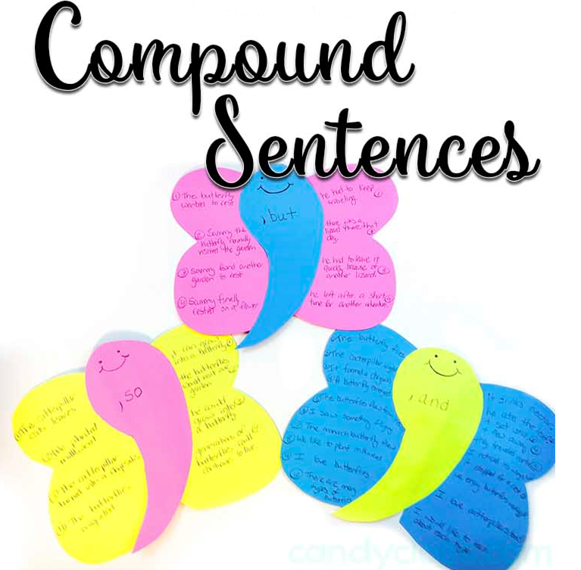
COMPOUND SENTENCES
When two sentences are combined in a way that shows they are of equal importance, the result is a compound sentence.
Such a sentence contains two complete subject-predicate constructs.
Each of the subject-predicate constructs could be an independent sentence; however, once they are connected, we call them independent clauses.
Reference: Ann Hogue (2003) The Essentials of English: A Writer’s Handbook. New York, Pearson Education, Inc

Slide 5
To connect the independent clauses, we use one of the following nexus:
A coordinate conjunction (and, but, or, nor, yet, so, for)
• A conjunctive adverb (however, therefore, etc.: see other conjunctive adverbs below)
To coordinate two or more parts of a sentence is to give them the same rank and role by making them grammatically alike.
You can coordinate words or phrases to make a compound sentence.
• Punctuation: A semicolon (;) comma (:) alone
Reference: Ann Hogue (2003) The Essentials of English: A Writer’s Handbook. New York, Pearson Education, Inc

Slide 6
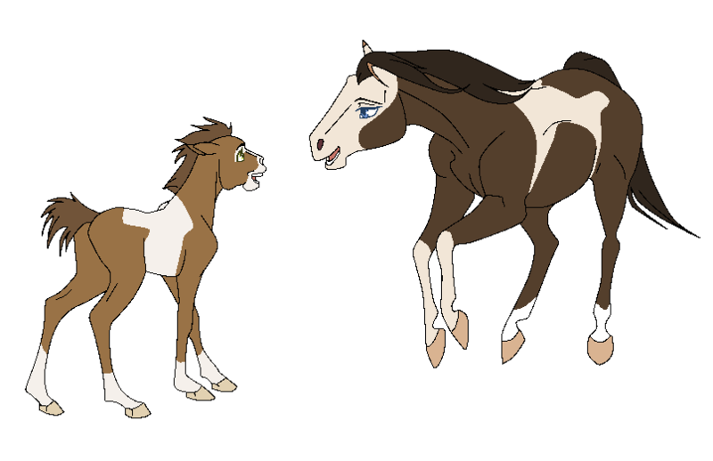
EXAMPLES
Coordinating conjunction
Their ancient nomadic spirit was suddenly free of the ground .
They acquired horses
and
clause
clause
JOINED BY CONJUNCTION

Slide 7
History does not stutter
;
It rhymes
clause
clause
JOINED BY SEMICOLON - Yuxtaposition

Slide 8
The average age for women to marry in Ireland is 26
women of India marry at an average age of fourteen.
; in contrast,
clause
clause
JOINED BY CONJUNCTIVE ADVERB

Slide 9
COORDINATING CLAUSES
They give independent information, the coordinating nexus only unites them and is not part of them.
Thus each proposition has complete meaning.
Example
Juan is in 5th and Ana is in 6th.
https://www.thoughtco.com/what-is-coordination-grammar-1689931

Slide 10
1. They are linked by coordinating conjunctions.
COORDINATE
CLAUSE FEATURES
2. Each clause has complete meaning.
3. Syntactically, the clauses are independent of each other, although thanks to the conjunctions they constitute a compound sentence.
Cambridgelms.org/main/p/splash

Slide 11
Oraciones yuxtapuestas: definición
El Diccionario de la Real Academia Española (DRAE) define la yuxtaposición como la "unión de dos o más elementos gramaticales contiguos del mismo nivel jerárquico y sin partículas intermedias que los relacionen"
Una de las características que define las oraciones yuxtapuestas es que carecen de nexo y en su lugar se unen entre sí a través de la asíndeton, que es un tipo de recurso lingüístico que consiste en la eliminación de los nexos o conjunciones que unen sintácticamente las oraciones.

Slide 12
Al no haber nexo, las dos partes de una oración yuxtapuesta pueden intercambiarse entre sí sin que el significado se alterase o cambiase.
Por ejemplo, es lo mismo
Juan lee, Carlos duerme
que lo contrario; es decir,
Carlos duerme, Juan lee.
Las oraciones yuxtapuestas suelen vincularse a través de una coma, un punto, un punto y coma o bien dos puntos.

Slide 13
Otra de las características de la yuxtaposición es que tanto la primera como la segunda oración se encuentran en igualdad de condiciones.
Se trata de una oración compuesta, formada por dos oraciones unidas a través de un signo gráfico de puntuación.
EJEMPLOS:
Mi hermano canta, mi amigo toca la guitarra, yo escribo las letras de las canciones.
Pedro ríe, Ana llora.
Marcos tiene fiebre, Paula tiene tos.
Esta mañana me he levantado temprano, he comido luego con mis amigas.
Igual voy al cine, no sé, tengo que mirar cuánto dinero tengo en la cartera.

Slide 14
Compound Sentences
Coordinating clauses
Sin nexo: | YUXTAPUESTAS
Con nexo: | COPULATIVAS DISYUNTIVAS ADVERSATIVAS Restrictivas Exclusivas

Slide 15
Proposiciones Coordinadas Copulativas
Son proposiciones que se expresan dentro de la oración como simple sumandos, sin connotaciones especiales.
¿Y cuáles son los nexos copulativos?
S) y – o – ni - que – pero - e - u ¡
E) f – a – n – b – o – y - s
Mi hermana estudia e Isabel trabaja.
Y (and)
E (and)
NI (nor)
Independent Clause
Independent Clause

Slide 16
El papá trabaja, la mamá cuida la casa y los niños van a la escuela.
Clause
Clause
Clause
NOR
She doesn’t drink milk, nor does she eat butter.
They were not wearing jackets, nor were they carrying umbrellas.
Clause with negative verb
Auxiliar
Subject
Main Verb

Slide 17
Syndetic coordination
The road was long, the weather was awful and we could not see the end.
Asyndetic coordination
It was a happy time, we needed a carefree time, it was a period of our lives which we will never forget.
Polysyndetic coordination
He has to study semantics and he needs a teacher of pragmatics and he has to do sociolinguistics' homework and he will have to pay for the syntax class.

Slide 18
Proposiciones Coordinadas Disyuntivas
Son proposiciones que expresan juicios contradictorios entre sí, de modo que no pueden realizarse simultáneamente.
O (or)
U (or)
If two clauses are joined by ‘or’, it means that this whole sentence will be true if at least one of the two clauses is true.
You can write on paper, or you can use a computer.
It is going to rain, or it is going to be sunny.

Slide 19
Proposiciones Coordinadas Adversativas
They are clauses that express ideas that are incompatible or at least contrary in a certain sense.
A tree fell onto the school roof in a storm, but none of the students was injured.
This incompatible or contrary ideas could be in a total or partial way.
BUT
Pero, sino

Slide 20
1. | Adversativa exclusiva | Hay una incompatibilidad entre dos juicios.
2. | Adversativa restrictiva | Corrige o restringe, pero no excluye lo expresado por la proposición anterior.
No lo hago por intereses personales, sino por el de mi patria.
Estoy feliz, pero tengo mucho trabajo pendiente.
The syntax of adversative coordination
a. Corrective but (sino) always requires its conjunction to be full clauses.
b. Contrastive but (pero) allows its conjuncts to be smaller than clauses.
Do not
forget!

Slide 21
Now, time to practice
but
I wanted to go to the beach, _______ Mary refused.
nor
or
and
but
nor
She was not wrong, ______ was she entirely right.
and
nor
or
but

Slide 22
DON’T Get tricked!
Sentences may contain coordinating conjunctions and not be compound. Allow me to show you some examples.
For instance:
Cathy and Dan visited us on Thanksgiving.
We ate turkey and played games.

Slide 23
COMPOUNDING WITH CONJUNCTIONS
Conjunctions include the set of words commonly known as:
F A N B O Y S
for
and
nor
but
or
yet
so

Slide 24
RELATIONS
V
The road was long, and we could not see the end.
S
C.C
S
V
1. SIMPLE ADITION
EXAMPLE
Compound sentence
S
V
V
S
C.C
She was not wrong, nor was she entirely right.
2. ADDITION OF A NEGATIVE POINT
EXAMPLE
C.S
S
V
C.C
S
V
I am very busy, but I help you.
I am eating steak, yet I really wanted lamb.
C.S
3. CONTRAST
EXAMPLE
S
V
C.C
S
V
C.S

Slide 25
FOR
S
V
C.C
S
V
SO
He was happy, for he just passed his exam.
Jack was wet, so he changed his clothes.
Compound sentence
4. LOGICAL CONSEQUENCE
EXAMPLE
S
V
C.C
S
V
C.S
5. CHOICE
S
V
C.C
S
V
EXAMPLE
Nelson is smart, or Nelson is lucky.
C.S

Slide 26
EXERCISES:
Mr. Smith is a pilot, but I have a headache.
Mr. Smith is a pilot, but he is soon retiring.
but
She speaks fast, _____ I understand her.
and but or as

Slide 27
PUNCTUATION WITH CONJUNCTIONS
There are two exceptions:
1. Omit the comma (,)
2. Replace the comma (,) with a semicolon (;)
EXAMPLE
EXAMPLE
Many are called but few are chosen.
On the morning of June 28, 1969, the weather finally cleared; but the climbers, wearied by their efforts of the previous days, could not attempt the summit.

Slide 28
Use a (,) without a conjunction when there are more than two clauses.
EXAMPLE
The sun shone, a stiff breeze ruffled the bay, the sails bellied out, and the bow cut the water like a knife.

Slide 29
OVERUSING AND
Use AND sparingly in compound sentences.
I was born in Illinois, and the first big city I ever saw was Chicago, and was I ever excited! I went there with my father and mother, and we stayed in a big hotel in the Loop, and I saw lots of interesting sights. We spent a whole day just walking around the city, and I got a stiff neck from looking up at the skyscrapers, and my feet got sore too from walking down so many streets. I was glad to go back to the hotel and take a long soak in the Jacuzzi
substitute other linking words—or other constructions:
Since I was born in Illinois, the first big city I ever saw was Chicago. Was I ever excited! My father and mother took me to a big hotel in the Loop. On the day after our arrival, we spent eight hours just walking around the city to see the sights. It was exhausting. In fact, I got a stiff neck from looking up at all the skyscrapers and sore feet from walking down so many streets. I couldn’t wait to take a long soak in the Jacuzzi at our hotel.

Slide 30
COMPOUNDING WITH THE SEMICOLON
EXAMPLES:
Some books are undeservedly ; none are undeservedly
forgotten remembered.
Too much, perhaps, has been ; too much stress has been laid
said of his silence upon his reserve.

Slide 31
Compounding with conjunctive adverbs
A conjunctive adverb shows a relation between two clauses, as a conjunction does but it is more emphatic than a conjunction.
Example:
You didn’t study for your test; as a result, you fail it.
I want to eat fry chicken and french fries.

Slide 32
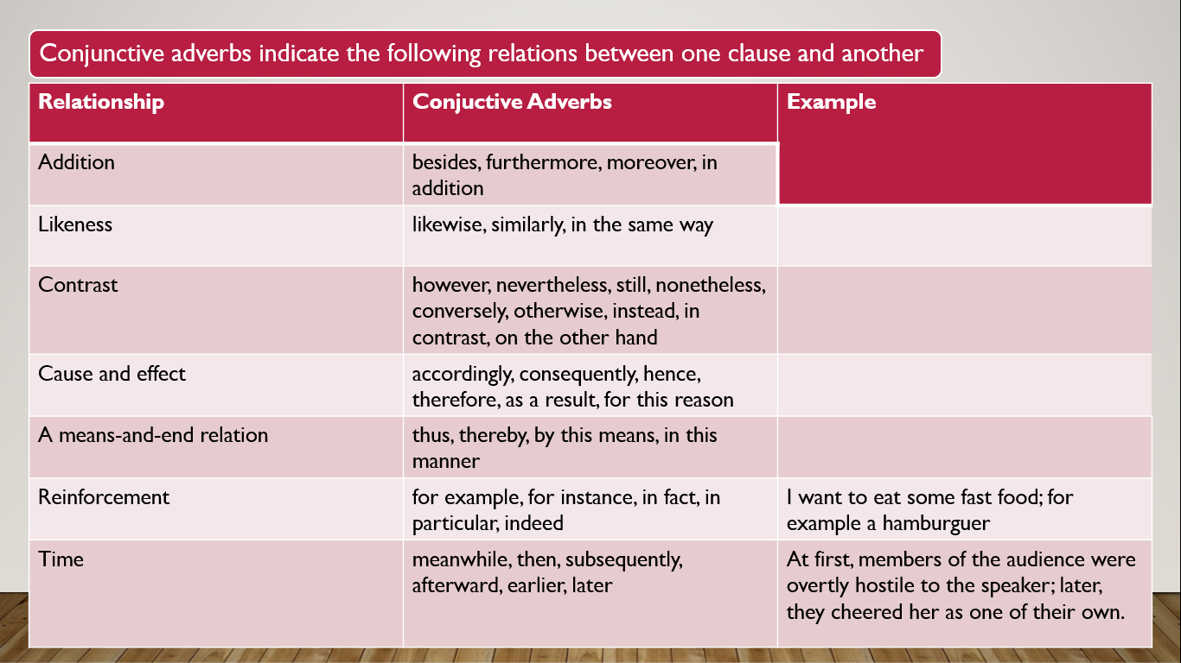
Conjunctive adverbs indicate the following relations between one clause and another
;
,

Slide 33
Editing comma splices
The comma splice is the error of joining two independent clauses—two possible sentences—with nothing but a comma.
Example:
One of the runners suffered from heat exhaustion, she collapsed two miles from the finish.
Notes:
When you use the comma to join or splice two distinct statements, you are probably trying to keep two related points together in one sentence. But the comma alone cannot do that for you. You should therefore do one of four things

Slide 34
Put a conjunction after a comma
One of the runners suffered from heat exhaustion, so she collapsed two miles from the finish.
Replace the comma with a semicolon
One of the runners suffered from heat exhaustion; she collapsed two miles from the finish.

Slide 35
Replace the comma with a semicolon and a conjunctive adverb
One of the runners suffered from heat exhaustion; as a result, she collapsed two miles from the finish.
Replace the comma with a period, making two sentences
One of the runners suffered from heat exhaustion. She collapsed two miles from the finish.

Slide 36
Spanish | English
Con nexo y en algunos casos sin nexo | With or without a link
ni | nor
Asíndeton, Polisíndeton | Asindeton, Polysyndeton
o, u | or
y, e | and
pero, sino | but
Sobre uso de “y” | Overusing “and”
CI, +CC+CI | IC, +CC+ IC
Clause+,+ conjuction+clause | Clause+,+ conjuction+clause
Likeness, cause and effect, reinforcement and time.

