Slide 3
What is a conjunction?
A conjunction is a part of speech that is used to connect words, phrases, or clauses.

Slide 4
Conjunction Rules
There are a few important rules for using conjunctions. Remember them and you will find that your writing flows better:
Conjunctions are for connecting thoughts, actions, and ideas as well as nouns, clauses, and other parts of speech.
Conjunctions are useful for making lists. For example: We made pancakes, eggs, and coffee for breakfast.
When using conjunctions, make sure that all the parts of your sentences agree.

Slide 5
Punctuation with coordinating conjunctions:
When a coordinating conjunction joins two words, phrases, or subordinate clauses, no comma should be placed before the conjunction.
A coordinating conjunction joining three or more words, phrases, or subordinate clauses creates a series and requires commas between the elements.
A coordinating conjunction joining two independent clauses creates a compound sentence and requires a comma before the coordinating conjunction.

Slide 6
COORDINATING CONJUNCTIONS
He is pretty stupid but quite eager
I was alone and sad
Adjective Phrase
Adjective Phrase
Word
Word

Slide 7
Coordinate or join.
They link units of equal syntactic status
Two or more sentences, main clauses, words

Slide 8
Coordinating Conjuction
ENGLISH
F
A
N
B
O
Y
S
FOR
AND
NOR
BUT
OR
YET
SO
Jane stayed in the jungle for she loves tarzan
I have to go to the job but I do not want
She didn’t study for the exam yet she passed it
I do not know the topic so I can not explain
I want pizza and soda
He doesn’t have family nor home
You eat ice cream or sandwich

Slide 9
Conjunciones Coordinantes
SPANISH

Slide 11
Subordinating conjunctions
Also known as subordinators
join two clauses
They make one clause dependent (or "subordinate") upon the other.

Slide 12
A subordinating conjunction may appear at a sentence beginning or between two clauses in a sentence.
Main clause + subordinating clause
Subordinating clause +, + main clause.

Slide 13
These words are commonly used as subordinating conjunctions
Cause
since
because
in order that
As, so that

Slide 14
Cause | Concession and Comparison | Condition | Place | Time
as because in order that since so that | although as as though even though just as though whereas while | even if if in case provided that unless | where wherever | after as soon as as long as before once still till until when whenever while

Slide 15
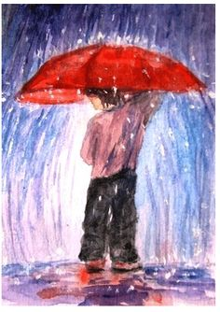
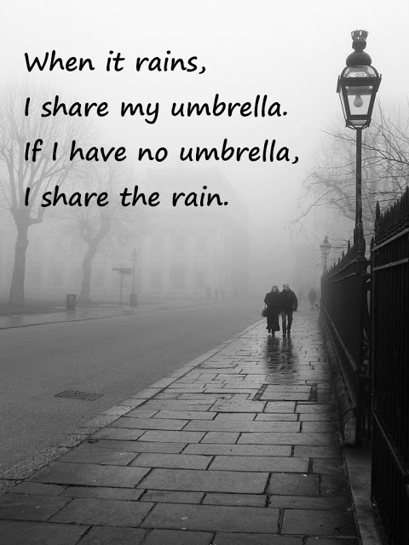
Examples
Because it is raining, we have an umbrella.
Dependent clause. comma
We have an umbrella because it is raining
Independent clause. No comma

Slide 16
CORRELATIVE CONJUNCTIONS

Slide 17
CONJUNCTION
MEANING
both …… and
whether ….. or
either …… or
neither …… nor
not …… but.
not only …..but also.
tanto …… como
si …… o
ya …… sea/o
ni …… ni.
no ….. sino.
no solo …..sino también.

Slide 18
Both/and
I’ll have both the cheesecake and the frozen hot chocolate.
They connect either two subjects or two objects:
Both John and Lauren enjoyed the movie. (subjects)
John enjoyed both the movie and the popcorn. (objects)

Slide 19
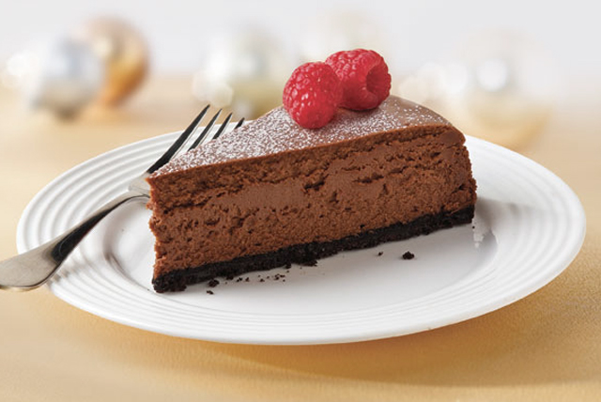
Whether/or
I didn’t know whether you’d want the cheesecake or the frozen hot chocolate, so I got you both.

Slide 20
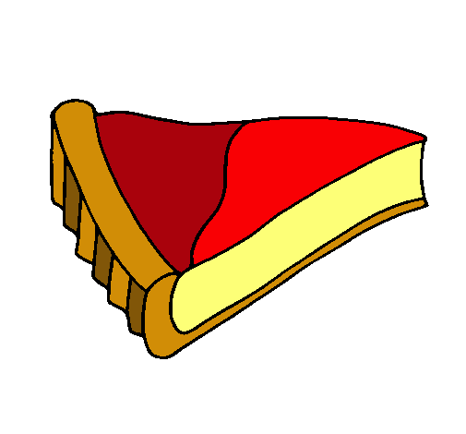
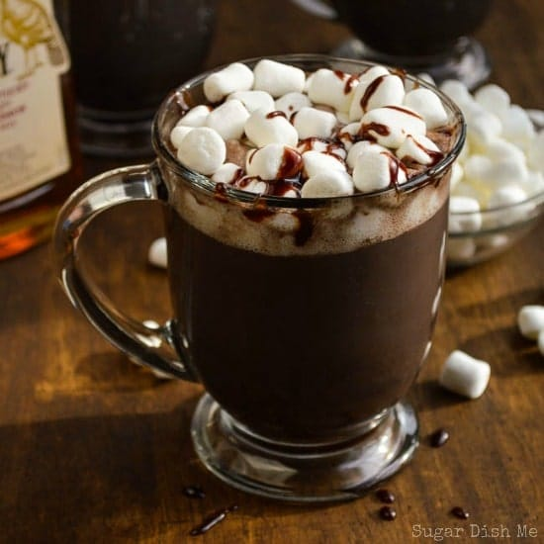
Either/or
I want either the cheesecake or the frozen hot chocolate.

Slide 21
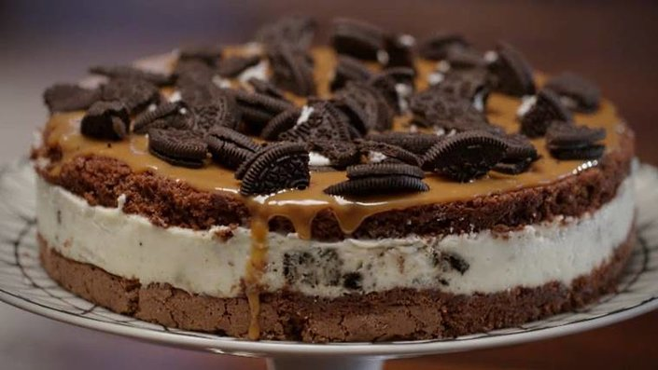
Neither/nor
Oh, you want neither the cheesecake nor the frozen hot chocolate? No problem.

Slide 22
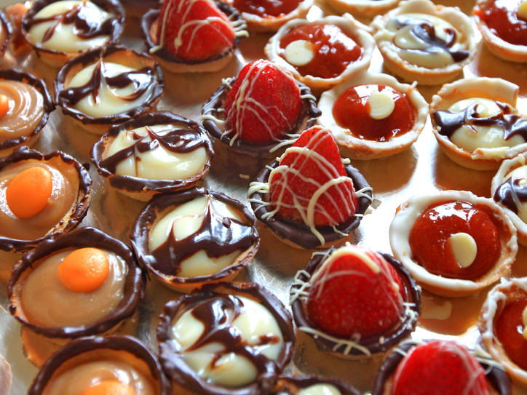
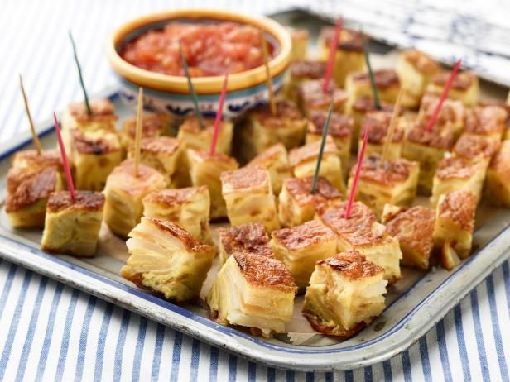
Not/but
I see you’re in the mood not for dessert but appetizers. I’ll help you with those too.

Slide 23
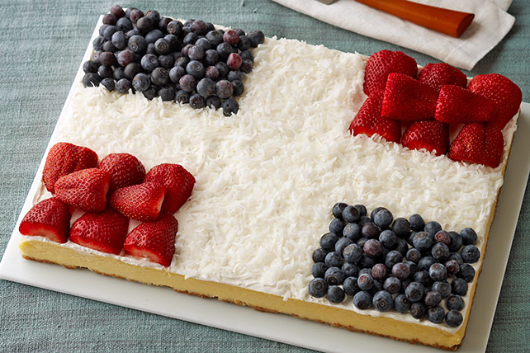
Not only/but also
I’ll eat them both - not only the cheesecake but also the frozen hot chocolate.

Slide 24
As…as - Bowling isn’t as fun as skeet shooting.
Such…that - Such was the nature of their relationship that they never would have made it even if they’d wanted to.
Scarcely…when - I had scarcely walked in the door when I got the call and had to run right back out again.
As many…as - There are as many curtains as there are windows.
No sooner…than - I’d no sooner lie to you than strangle a puppy.
Rather….than - She’d rather play the drums than sing.

Slide 25
CONJUNCTIVE ADVERBS

Slide 26
What is a conjunctive adverb?
adverb or adverbial phrase
Relation independent clauses
*conjunct, *transitional conjunction, *cohesive conjunction
beginning of the main clause

Slide 27
at the beginning of the main clause
when both clauses are independent and can stand alone

Slide 28
ADDITIONAL RULES
Always use a period or semicolon before the conjunctive adverb when separating two independent clauses. Conjunctive adverbs are not strong enough to join independent clauses without supporting punctuation.
Use a comma if a conjunction such as and, but, or, or so appears between the conjunctive adverb and the first clause
If a conjunctive adverb appears in the middle of a clause, it should be enclosed in commas most of the time. This is not an absolute rule and does not normally apply to short clauses”.
5

Slide 29
How to Identify Conjunctive Adverbs
a connecting word is a conjunctive adverb
test by moving the connecting word to another place in the clause
Conjunctive adverbs can be moved;

Slide 30
.
;
,

Slide 31
EXAMPLES
Jeremy kept talking in class; therefore, he got in trouble.
She went into the store; however, she didn’t find anything she wanted to buy.
I like you a lot; in fact, I think we should be best friends.

