Slide 1
ENGLISH
SPANISH
/ -l /
/ ɹ /
/ w /
/ j /
Continue

Slide 2
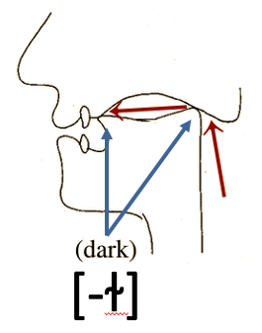
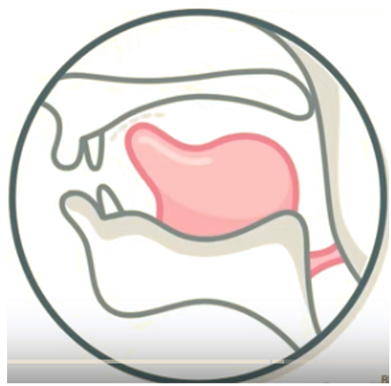
ENGLISH - SPANISH
/ɹ/

Slide 3
/w/ PRODUCTION PICTURE Spanish-English
S: https://soundsofspeech.uiowa.edu/spanish
E: https://www.youtube.com/watch?v=nMB5mX_PGHQ

Slide 4
SPANISH and ENGLISH /w/
Spanish /w/
English /w/
/w/ voiced, bilabial, dorso-velar, oral, approximant.
/w/ voiced, bilabial, dorso-velar, oral, approximant.
[w-] + strong v.s. voiced, bilabial-dorso, velar, oral, semiconsonant. (diphthong)
[w-] + strong v.s. voiced, bilabial-dorso, velar, oral, semiconsonant. (diphthong)
strong v.s.+[-ʊ̯] voiced, bilabial-dorso, velar, oral, semivowel. (diphthong)
strong v.s. + [-u̯] voiced, bilabial-dorso, velar, oral, semivowel. (diphthong)
[^{g}w-] voiced, bilabial-dorso, velar, oral, semiconsonant, G-colored. (diphthong)

Slide 5
PHONETIC AND PHONEMIC DISTRIBUTION
Spanish /w/
diphthong
Distribution | /w/ | [ ^{g}w -] | [ w -] | [-u̯ ]
I <hue-> | /weɾto/ | [ˈ^{g}wɛɾ̪to] | [ˈwɛɾ̪to] | ---
c+M | /ˈkwaɾso/ | --- | [ˈkwaɾso] | ---
V+M | /kawˈdal/ | --- | --- | [kau̯ˈðal]
v + F | --- | --- | --- | ---
Broad distribution is Partial
Narrow distribution is Partial, Complementary and Free variation

Slide 6
PHONETIC AND PHONEMIC DISTRIBUTION
English /w/
Distribution | /w/ | [w-] | [-ʊ̯]
I | /wejt/ | [weɪ̯t ̚ ] | ---
c+M | /kwjt/ | [kʰwɪ̯t ̚ ] | ---
V+M | /fjwəɹ/ | --- | [fjʊ̯ɚ]
v + F | /kaw/ | --- | [kʰaʊ̯ː]
Broad distribution is Total
Narrow distribution is Partial and Complementary

Slide 7
CONTRASTIVE TRANSFER ANALYSIS
Spanish |  | English
/w/ | + | /w/
[ w- ] | + | [ w- ]
[-u̯] | Ø | —
— | Ø | [-ʊ̯]
[^{g}w-] | Ø | —
<= Common mistake

Slide 8
/j/ PRODUCTION PICTURE Spanish-English
/j/
approximant
S: https://soundsofspeech.uiowa.edu/spanish
E: https://www.youtube.com/watch?v=1G8SCotE2yg

Slide 9
SPANISH and ENGLISH /j/
Spanish /j/
English /j/
/j/ voiced, fronto-palatal, oral, approximant
/j/ voiced, fronto-palatal, oral, approximant.
[j-] + strong v.s. voiced, fronto-palatal, oral, semiconsonant (diphthong)
[j-] + strong v.s. voiced, fronto-palatal, oral, semiconsonant (diphthong)
strong v.s. + [-ɪ̯] voiced, front-palatal, oral, semivowel (diphthong)
strong v.s. + [-i̯] voiced, front-palatal, oral, semivowel (diphthong)

Slide 10
PHONETIC AND PHONEMIC DISTRIBUTION
Spanish /j/
Distribution | /j/ | [ j- ] | [-i̯]
I | — | — | —
M+v.s. | /ˈljenso/ | [ˈljẽnso] | —
v.s. + M | /kwjˈdaɾ/ | — | [kwi̯ˈðaɾ]
v+F | /fwj/ | — | [ fwi̯ ]
Broad distribution is partial.
Narrow distribution is partial and complementary

Slide 11
PHONETIC AND PHONEMIC DISTRIBUTION
English /j/
Distribution | /j/ |  | [ j ] | [ ɪ̯ ]
I | --- | --- | — | —
M+v.s. | /fəˈmɪljəɹ/ | — | [fəˈmɪːljɚ] | —
v.s.+M | /ˈmɛʝənejz/ | — | — | [ˈmɛːʝəneɪ̯z]
v.s.+F | /ˈboj/ | — | — | [ˈbɔɪ̯ː]
Broad distribution is partial
Narrow distribution is partial and complementary

Slide 12
CONTRASTIVE TRANSFER ANALYSIS
Spanish |  | English
/j/ | + | /j/
[ j- ] | + | [ j- ]
[-i̯] | Ø | —
— | Ø | [-ɪ̯]
<=Common mistake
√
Mejía, P. (2013). Contrastive Phonology. A Descriptive Linguistics Course for Spanish-English Teachers. Classroom Publishing.

