Slide 1
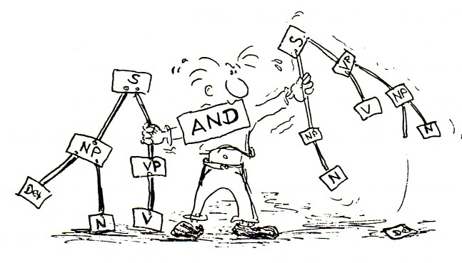
PREPOSITION

Slide 2
DEFINICIÓN SINTÁCTICA
SYNTACTIC DEFINITION
Es un nexo subordinante. Subordina un elemento llamado término ( al que precede siempre) a otro elemento llamado inicial.
The word class or prepositions cannot easily make reference to formal characteristics. You can say that prepositions tend to be very short, often consisting of only two or three letters. From the point of view of meaning, we can say that prepositions often denote a relationship of some sort between two entities.

Slide 3
THE PREPOSITIONS ARE:
A – ANTE – CON – CONTRA - DE – DESDE - EN – ENTRE – HACIA – HASTA – PARA - POR- PRO – SEGÚN - SIN - SOBRE- TRAS.
TO – BESIDE – AROUND – UNDER - WITH AGAINST - OF - OUT OF - FROM.

Slide 4
Within the sentence, the element can go behind the term:
Preposición + Término => Complemento (frase – sintagma) Preposicional
e.g.
•Escuchaba las quejas con gran paciencia.
Elemento inicial + nexo + Término
•Con gran paciencia, escuchaba las quejas.
nexo +Término + Elemento inicial
Changing the placement of the syntactic elements (syntactic structure) does not vary the relationship between them (syntactic function).
Complemento Circunstancial

Slide 5
The men are working for the money.
Initial item + linker + Object of the preposition
Put the vase by the window.
Initial item + linker + Object of the preposition
Every morning, we take a walk in the park.
Initial item + linker + Object of the preposition
Circumstantial Complement
Circumstantial Complement
Circumstantial Complement

Slide 6
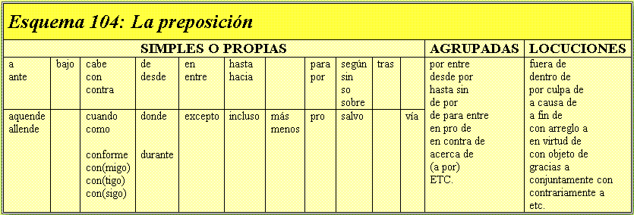
SPANISH

Slide 7
ENGLISH
ENGLISH

Slide 8
PREPOSITIONAL PHRASE

Slide 9
Éstas están formadas por una preposición inicial y por un sustantivo.
Ejemplo: Elena llegó a la casa con un enorme paquete.
Podemos ver que la frase con un enorme paquete es la frase preposicional, ya que cumple con lo requerido en la regla anterior.

Slide 10
‘Prepositional phrase’ is how a group of words containing prepositions is called.
They always consist of two basic parts: preposition and the object of the preposition.

Slide 11
Prepositional phrases fulfill two syntactic functions:
1. Adjective phrases.
These always have an adjective as the main part of the group. It modifies a noun.
e.g.: A fearless woman was shouting at the President when he was passing by.
A woman with no fear was shouting at the President when he was passing by.
Noun Phrase = Subject
Prep. Phrase = Post NM = Adjective

Slide 12
As seen before, the adjective ‘fearless’ was replaced with the phrase ‘with no fear’, that still performs as an adjective, because it is modifying the noun, in this case, the woman.

Slide 13
2. Adverbial phrases
Now we have adverbial phrases. These, on the other hand, always have an adverb as the main part of the phrase.
e.g.: Without a doubt, they will win the game.
Prep. Phrase = Circumstantial Complement = Adverb

Slide 14
SYNTACTIC STRUCTURES & FUNCTIONS SPANISH - ENGLISH

Slide 15
VERBO (VERB) + …
Término / obj. of a prep.
Verb + nexus + term
VERBOIDE Él salió a pasear. He went out for a walk.
SUSTANTIVO Murió de cáncer He died of cancer.
PRONOMBRE Llegó con él. He arrived with him.
ADJETIVO Se pasa de tonto. He goes from fool. He’s so stupid ADVERBIO Entró por allá. He came in there.
PROPOSICIÓN Perdono a quien me ofende. I forgive to who offends me

Slide 16
VERBOIDE (Non-Finite Verb) + …
Término / Obj. of a prep.
Verboide /Nonfinite verb + nexus + Obj. Prep
VERBOIDE Comer hasta hartarse. To eat up.
SUSTANTIVO Vivir sin problemas. To live without problems.
PRONOMBRE Trabajando con él. Working with him.
ADJETIVO Castigado por desobediente. Punished for disobedience (n)
ADVERBIO Esperando desde ayer. Waiting since yesterday.
PROPOSICIÓN Amonestado por llegar tarde. Repreimanded for being late

Slide 17
SUSTANTIVO (NOUN) + …
Término / Obj. of a prep.
Noun + nexus + term
VERBOIDE Máquina de coser. Sewing machine
SUSTANTIVO Celular sin aplicaciones. Animals without owners are dying
PRONOMBRE Libros de ella. Friends of mine
ADVERBIO Ruido de lejos Noise from afar
PROPOSICIÓN La ilusión de que yo le apoye. The illusion that I support
him

Slide 18
ADJETIVO (ADJECTIVE) + …
Término / Obj. of a prep.
Adjective + nexus + term
VERBOIDE Enojado por llegar tarde. Angry for being late.
SUSTANTIVO Ancho de espaldas. Wide on his back.
PRONOMBRE Encantado con nosotros. Surprised at you.
ADVERBIO Complaciente hasta aquí. Complacent up to here.
PROPOSICIÓN Bueno para curar heridas. Good to heal wounds.

Slide 19
ADVERBIO (ADVERB) + …
Término / Obj. of a prep.
Adverb + nexus + term
VERBOIDE Lejos de terminar. Far from finishing.
SUSTANTIVO Aquí sin Anita. Here without love.
PRONOMBRE Fielmente cerca de ti. Faithfully close to you.
ADVERBIO Cerca de aquí. near here.
PROPOSICIÓN Antes de que amanezca. Before you do it

Slide 20
SPANISH
La casa madera se incendió.
El incendio fue apagado los bomberos.
Es bueno hasta matemáticas.
mucha inteligencia, desarrolló su proyecto PIS
de
por
en
Con

Slide 21
ENGLISH
I forgive who offends me
The dog jumped the fence
my positive attitude, Mary chose me as a group leader.
My mom goes a work on Saturday mornings
to
over
For
for

