Slide 1
PABLO MEJÍA MALDONADO

Slide 2
S: https://soundsofspeech.uiowa.edu/spanish
E: https://www.youtube.com/watch?v=JamM8TgB_AA
E: https://www.youtube.com/watch?v=ZTgYjGXFAkw

Slide 3
SPANISH and ENGLISH /l/
Spanish /l/
English /l/
/l/ voiced, apico-alveolar, oral, lateral.
/l/ voiced, apico-alveolar, oral, lateral.
[l] voiced, apico-alveolar, oral, lateral.
[l] voiced, apico-alveolar, oral, lateral.
vls.c.s. + [ -l̥- ] voiceless, apico-alveolar, oral, lateral
vl.c.s. + [ -l̥- ] voiceless, apico- alveolar, oral, lateral
[ -ǀ̪- ] t/d voiced, apico-dental, oral, lateral
[ -ɫ ] voiced, apico-alveolar, velarized, oral, dark, lateral.
x
c+ə+[-ɫ̩] voiced, apico-alveolar, velarized, oral, dark, lateral, syllabic.

Slide 4
[-ɫ] English
[ l ]
[-ɫ]
-
- -

Slide 5
PHONEMIC AND PHONETIC DISTRIBUTION
Spanish /l/
Distribution | /l/ | [l] | [ ǀ̪ ] | [ l̥ ]
I | /ˈlata/ | [ˈlata] | - | -
M | /ˈpalma/ | [ˈpalma] | - | -
vl.c+M | /ˈfleko/ | - | - | [ˈfl̥eko]
M+t/d | /ˈalto/ | - | [ˈal̪to] | -
F | /ˈsal/ | [ˈsal] | - | -
P.A
R.A
Broad distribution is total.
Narrow distribution is total and complementary.

Slide 6
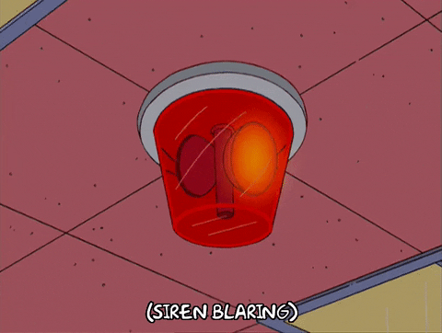
PHONEMIC AND PHONETIC DISTRIBUTION
English /l/
simple, light, regular,clear
dark
Distribution | /l/ | [l] | [ l̥ ] | [-ɫ] | [-ɫ̩ ]
I | /ˈlæm/ | [ læːm] | - | - | -
M | /ˈsɛldəm/ | [ˈsɛːldəm] | - | - | -
Vl.c+M | /ˈpleyn/ | - | [ pʰl̥eɪ̯ːn] | - | -
V+F | /ˈfɪl/ | - | - | [ fɪːɫ ] | -
C+F | /ˈæpəl/ | - | - | [ˈæpəɫ] | [ˈæpɫ̩]
Broad distribution is total.
Narrow distribution is partial, complementary, and free variation.

Slide 7
CONTRASTIVE TRANSFER ANALYSIS
Spanish |  | English
/ l / | + | / l /
[ l- ] | + | [ l- ]
[ -l- ] | + | [ -l- ]
[ -l̪- ] <=[-t,-d] | Ø | —
vls.c.s<= [ -l̥- ] | + | vls.c.s <= [ -l̥- ]
[ -l ] | Ø | —
— | Ø | [ -ɫ]
— | Ø | [ -ɫ̩]
X
[ -l ]
<= common mistake
<= correct sounds

Slide 8
SPANISH / ʎ / and ENGLISH /-/
S: https://soundsofspeech.uiowa.edu/spanish

Slide 9
SPANISH / ʎ / and ENGLISH /-/
Spanish / ʎ /
English /-/
/ ʎ / voiced, fronto-palatal , oral, lateral.
/ ʎ / does not exist.
[ ʎ ] voiced, fronto-palatal , oral, lateral.
(IPA) [ ʝ ] / (APA)[y] voiced, fronto-palatal , oral, fricative.
[ ʒ ] voiced, fronto-palatal , oral, groove, fricative.
[dʒ] voiced, apico-alveolar lamino fronto-palatal , oral, affricate.

Slide 10
PHONETIC AND PHONEMIC DISTRIBUTION
English /-/
Spanish / ʎ /
Vd, fronto-palatal, oral
X
Distribution | / ʎ / | [ʎ] | [ʝ] | [ʒ] | [dʒ]
I | /ʎeˈnaɾ/ | [ʎeˈnaɾ] | [ʝeˈnaɾ] | [ʒeˈnaɾ] | [dʒeˈnaɾ]
M | / ˈseʎo / | [ˈseʎo ] | [ˈseʝo ] | [ˈseʒo ] | [ˈsedʒo ]
F | —— | —— | —— | —— | ——
Broad distribution is Partial
Narrow distribution is Partial and Free Variation

Slide 11
CONTRASTIVE TRANSFER ANALYSIS
Spanish |  | English
/ ʎ / | Ø | —
[ ʎ- ] | Ø | —
[ -ʎ- ] | Ø | —
[ʝ ] | - | / ʝ /
[ ʒ ] | - | / ʒ /
[dʒ] | - | /dʒ/
Reference:
Mejía, P. (2013). Contrastive Phonology. A Descriptive Linguistics Course for Spanish-English Teachers. Classroom Publishing.

