Slide 1
Oración / Sentence
Unimembre / Minor sentence
Bimembre / Major Sentence

Slide 2
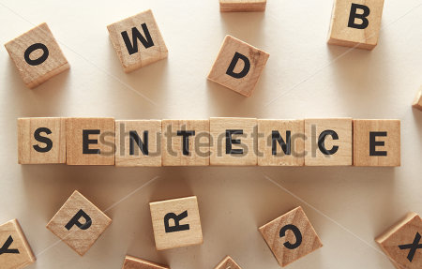
La oración unimembre The minor sentence
This is a fragmented or incomplete sentence or clause that still conveys meaning: Eg, So far so good, No pain no gain, Yes Indeed!
Also called a minor clause, an abbreviated clause, or a sentence fragment. Every primary or secondary interjection is a minor sentence.
Consta de un solo miembro o constituyente. Son unidades del habla con sentido en sí mismas: Eg, Gracias, Caminar sin rumbo, ¡Silencio!, Los gratos recuerdos de la infancia, a la buena de Dios.
Tiene autonomía sintáctica, pero no puede dividirse en sujeto y predicado.
Revilla, S. 1986. Gramática Española Moderna. McGraw-Hill. México
Notes:
Title: Explain what is a sentence/
Image: ask for sentence parts or “members” /
Def: define where is the meaning from/
2def: Short answers

Slide 3
Types of minor sentences
ANSWER
RESPUESTA
Por supuesto / Certainly.
INTERJECTION
INTERJECCIÓN
EXCLAMATION
EXCLAMACIÓN
¡ Uff ! / Yuppie!
Ay de tí! / OMG!
EXPRESSION
EXPRESIÓN
IMPERATIVE
IMPERATIVO
Habría que ver
Better safe than sorry.
VOCATIVE
VOCATIVO
¡Ven! / don’t miss out!
Hey¡ Come up!
!Oye¡Silencio!

Slide 4
Syntactic Classification
Nominal
Comparative
Adjectival
Prepositional
Verbal
Adverbial
Verboidal Non-finite Verb

Slide 5
Oraciones Unimembres MINOR SENTENCE
NOUN
Notes:
none of those phrases or words function as a subject or as a predicate.

Slide 6
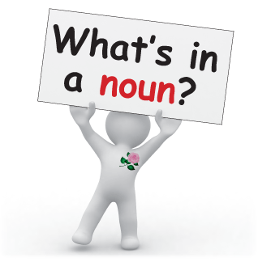
Oraciones Unimembres Sustantivas
Minor Noun Sentences
Noun by itself / Sustantivo solo
Syntactic
structure
Noun Phrase / Sintagma Nominal
Spanish
English

Slide 7
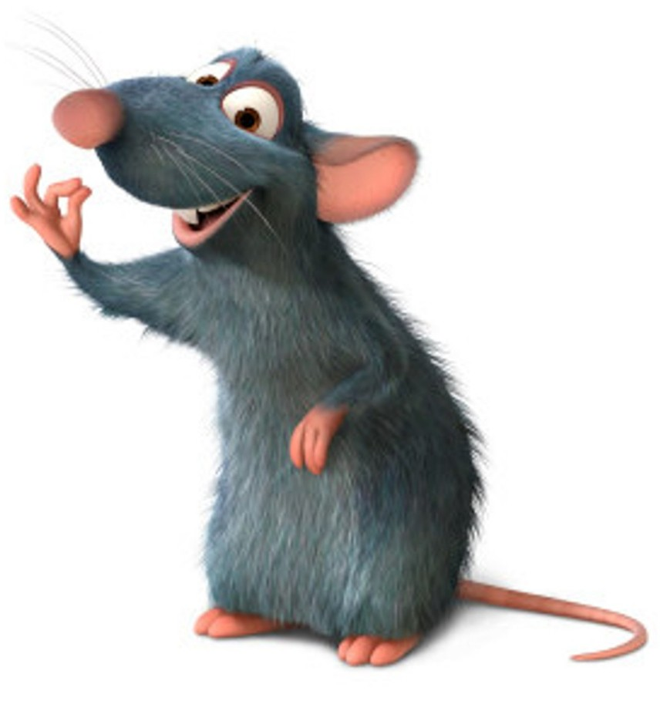
Oraciones Unimembres Sustantivas
(Minor Noun Sentences)
1
Noun by itself
Spanish
Eg: ¡Silencio!
Eg: ¡Maravilla!
Eg: Oops!.
English
Eg: Rats!

Slide 8
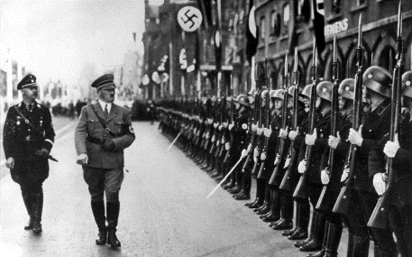
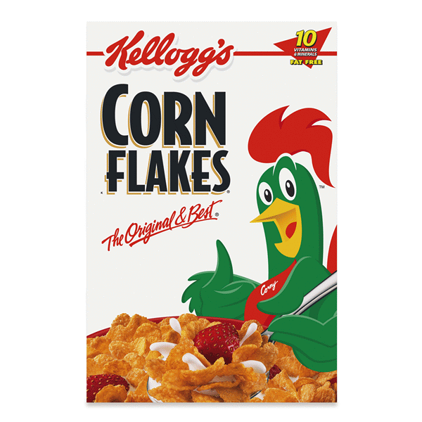
Oraciones Unimembres Sustantivas
(Minor Noun Sentences)
2
Construcción Sustantivada / Noun Phrase
Art.
N
Pr
Art
Adj
Spanish
Eg: Una lucha sin tregua.
Eg: La segunda guerra mundial.
N
N
Adj
Adj
N
English
Eg: Another stripe on the tiger!
Eg: Corn flakes.
Adj
N
Pr
Art
N

Slide 9
THE MINOR SENTENCE
ADJECTIVE
Notes:
none of those phrases or words function as a subject or as a predicate.

Slide 10
Oraciones Unimembres Adjetivas
Adjectives
S
E
Modificador directo (sin nexo)
Commonly = Modify nouns
Atributo del sustantivo
Certain formal characteristics
Most adjectives are gradable
Comparative and superlative endings /-er/ /-est/

Slide 11
Oraciones Unimembres Adjetivas
(Minor Adjective Sentences)
Adjective by itself
(Adjetivo solo)
Adjectival Phrase
1
2
Eg: cansado de sufrir
Eg: cansado
Spanish
Spanish
Adj
Pr. phrase
Adj. Phrase
English
Eg: impatient
Eg: guilty for homicide
English
Adj
Pr. phrase
Adj. Phrase

Slide 12
THE MINOR SENTENCE
VERB
Notes:
none of those phrases or words function as a subject or as a predicate.

Slide 13
Oraciones Unimembres Verbales
Verbs
S
E
Elemento central
Commonly = Action words
Núcleo del predicado
Inflections s and es
Tense inflection = Present 3rd P. S
TO BE = auxiliary, main verb
DO VERB = main auxiliary

Slide 14
Oraciones Unimembres Verbales
(Minor verbal Sentences)
Verb by itself
(Verbo solo)
Imp. verb
2
Verbal Phrase
1
Eg: Llueve en Quito
Eg: Nieva
Spanish
Spanish
V
Adv
V. Phrase
English
Eg: Go!
Eg: Sleep well
English
V
Adv
V. Phrase

Slide 15
THE MINOR SENTENCE
ADVERB
Notes:
none of those phrases or words function as a subject or as a predicate.

Slide 16
ADVERB: DEFINITION
Typically express:
Answering questions such as:
how?,
manner,
place,
time,
frequency,
degree,
level of certainty, etc.,
in what way?,
when?,
where?,
and to what extent?.

Slide 17
ADVERB: TYPES

Slide 18
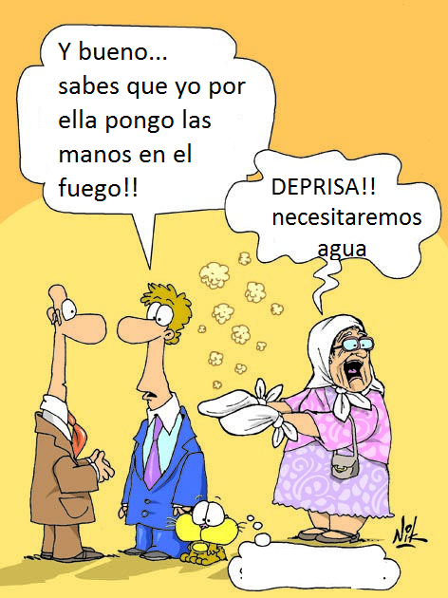
DEPRISA!! Necesitaremos agua
Adverbio autónomo
Oración simple
5 EJEMPLOS

Slide 19
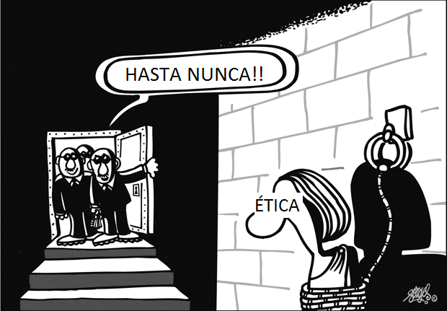
adverbio
En ninguna ocasión.
HASTA NUNCA!!
Indica el momento en que se inicia una acción o en el que habrá de ocurrir algo.
5 EJEMPLOS

Slide 20
ADVERB: EXAMPLES AS MINOR SENTENCES
Dónde lo dejamos? Aquí! (Indicando lugar)
Left Where? Here! (Showing place)
Cuando trabajaste? Ayer! (indicando tiempo)
I worked Yesterday? (Showing time)
Tú cometes errores? No, nunca! (indicando tiempo)
Do you make mistakes? Almost never (Showing frequency)
¿Él lo hizo? Indudablemente sí. (indicando certeza)
Did he do it? Undoubtedly yes. (Showing certainty)

Slide 21
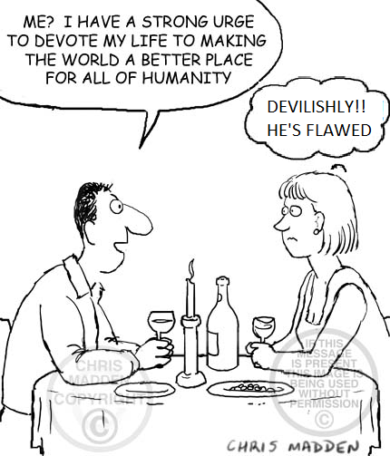
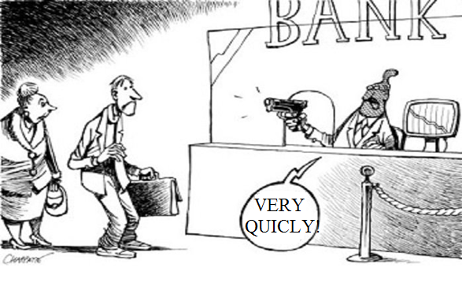

Slide 22
THE MINOR SENTENCE
PREPOSITION
Notes:
none of those phrases or words function as a subject or as a predicate.

Slide 23
PREPOSITIONS: DEFINITION
Prepositions are links with subordinating function.
The union is carried out with one or several words.
Prepositions are non-variable words that relate the components of a sentence favoring to give them meaning.
The significance given by the prepositions responds to circumstances of:
movement,
place,
time,
manner,
cause,
possession,
belonging,
matter and origin.
Notes:
The first rule is that certain propositions must be used to make the relationships between words in a sentence clear. Most prepositions are interchangeable but only to a certain extent.
The second rule for using prepositions is that these words must be followed by nouns.

Slide 24
Function | Sentence
Position | Under the table. On the chair. In the box.
Time | At 8 am. On Wednesday.
How something is done | By hand.
Possession | Of the kitchen. Of the dogs.
\in the tree \outside . | (one word compound)
\on top of the tree \outside of IN FRONT OF | (multiword compounds)
From June 10 to June 23. | (This is an unusual one because the parts of the preposition are interrupted.)

Slide 25
on top of the world

Slide 26
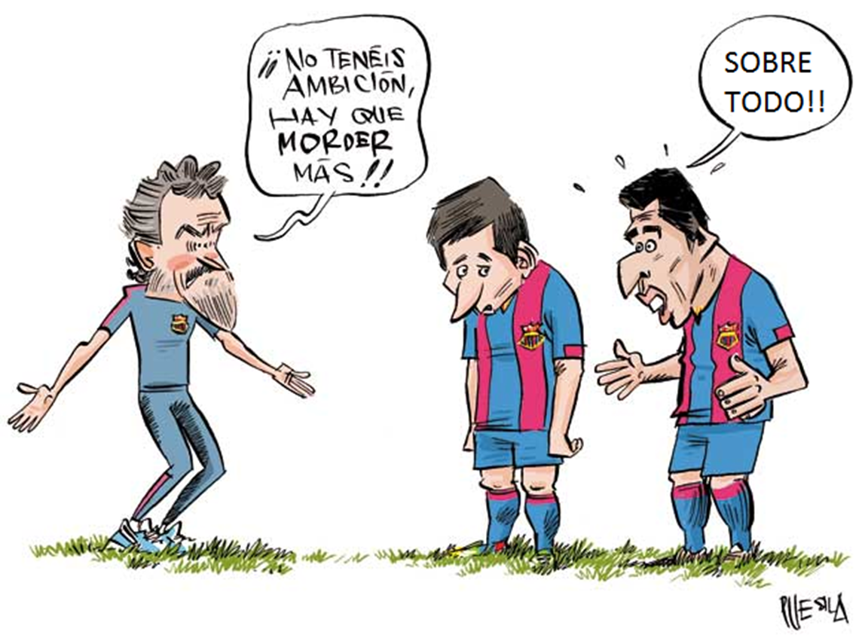
Function | Sentence
A | A la tía. A Estados Unidos.
Ante | Ante todos. Ante las adversidades.
Con | Con leche. Con mis hermanos.
De | De limones. De mi compañera Nicky.

Slide 27
THE MINOR SENTENCE
NON - VERB
Notes:
none of those phrases or words function as a subject or as a predicate.

Slide 28
Minor non-finite verb Sentences
(Oraciones Unimembres Verboidales)
Known as impersonal verbs
Cannot be combined
Incomplete form of the verb

Slide 29
Non-finite verb
INFINITIVE

Slide 30
It can express the meaning
of the verb in a general way.
Infinitive
S
CONTRAST
E
Infinitivo
Puede ser usado como el sujeto en una oración. Simple: aprobar- corregir
Compuesto: haber aprobado
haber corregido
Infinitive
Progressives:
To be speaking
Perfect:
To have spoken
Passives:
To be spoken

Slide 31
Infinitive
(Minor non-finite Sentences)
Infinitive
Infinitive phrase
Spanish
Eg: Correr riesgos.
Spanish
Eg: dormir
Eg: to go
English
English
Eg: To wait for more.

Slide 32
PARTICIPLE
Non-Finite Verb
GERUND

Slide 33
It is the impersonal form of the verb that expresses the present participle.
Gerund
S
E
Contrast
Funcionan como adverbios. Son modificadores de un verbo.
It can be used as a subject of an expression:
Swimming

Slide 34
Gerunds
(Minor gerund Sentences)
Gerund
Gerund phrase
Spanish
Eg: Planchando una camisa
Spanish
Eg: caminando
Eg: sleeping
English
English
Eg: Sleeping as a child

Slide 35
It is an impersonal form of the verb that expresses an action or an adjective
Past Participle
E
Contrast
It sometimes works as an adjective or subject.
Regular: -ed asked
Irregular: eat = eaten
S
Lo podemos usar para representar a un adjectivo en la oración.
Regulares: -ido temido. Irregulares: -to escrito, -so impreso, -cho dicho

Slide 36
Past Participle
(Minor past participle sentences)
Past participle
Past participle phrase
Spanish
Eg: El niño bendecido
Spanish
Eg: bendecido
Eg: seen
English
English
Eg: Found in the forest

Slide 37
THE MINOR SENTENCE
COMPARATIVE
Notes:
none of those phrases or words function as a subject or as a predicate.

Slide 38
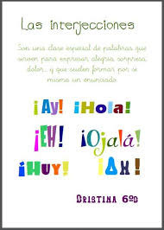
ORACIONES UNIMEMBRES COMPARATIVAS
CONTRAST
SPANISH
ENGLISH
Tienen construcción preposicional
Prepositional construction
Se emplean mucho las interjecciones

Slide 39
ORACIONES UNIMEMBRES COMPARATIVAS
MINOR COMPARATIVE SENTENCE
EXAMPLES
Terco como una mula!
SPANISH
Like father, like son
ENGLISH
Prep.
Noun
Prep.of possibility
Noun
Prep. Phrase.
Prep. Phrase

